Slide 1
CHBE 424:
Chemical Reaction Engineering
Introduction & Lecture 1

Slide 2
What is Chemical Reaction Engineering (CRE) ?
Understanding how chemical reactors work lies at the heart of almost every chemical processing operation.
Design of the reactor is no routine matter, and many alternatives can be proposed for a process. Reactor design uses information, knowledge and experience from a variety of areas - thermodynamics, chemical kinetics, fluid mechanics, heat and mass transfer, and economics.
CRE is the synthesis of all these factors with the aim of properly designing and understanding the chemical reactor.
Raw
material
Separation Process
Chemical process
Separation Process
Products
By-products

Slide 3
How do we design a chemical reactor?
Type & size
Maximize the space-time yield of the desired product (productivity lb/hr/ft³)
Stoichiometry
Kinetics
Basic molar balances
Fluid dynamics
Reactor volume
Use a lab-scale reactor to determine the kinetics!

Slide 4
Reactor Design
Reaction
Stoichiometry
Kinetics: elementary vs non-elementary
Single vs multiple reactions
Reactor
Isothermal vs non-isothermal
Ideal vs nonideal
Steady-state vs nonsteady-state

Slide 5
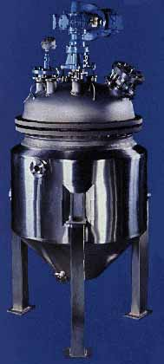
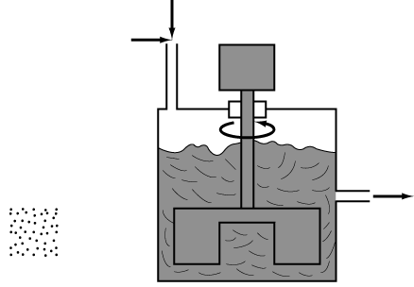
What type of reactor(s) to use?
in
Continuously Stirred
Tank Reactor (CSTR)
out
Plug flow reactor (PFR)
Well-mixed batch reactor

Slide 6
What size reactor(s) to use?
Answers to this questions are based on the desired conversion, selectivity and kinetics
Kinetics
Reactor type &
size
Conversion
&
selectivity
Material &
energy
balances

Slide 7
Chemical Reaction
A detectable number of molecules have lost their identity and assumed a new form by a change in the kind or number of atoms in the compound and/or by a change in the atoms’ configuration
  Decomposition
  Combination
  Isomerization
Rate of reaction
  How fast a number of moles of one chemical species are being consumed to form another chemical species

Slide 8
Rate Law for r_{j}
r_{A}: the rate of formation of species A per unit volume [e.g., mol/m^{3•}s]
-r_{A}: the rate of a consumption of species A per unit volume
1st order in A, 1st order in B, 2nd order overall
n^{th} order in A
Michaelis-Menton: common in enzymatic reactions
r_{j} depends on concentration and temperature:

Slide 9
Basic Molar Balance (BMB)
F_{j0}
F_{j}
G_{j}
System volume
Rate of flow of j into system
Rate of flow of j out of system
Rate of generation of j by chemical rxn
Rate of decomposition of j
-
+
-
=
Rate of
accumulation
combine
N_{j}: moles j in system at time t
in
out
generation
=
accumulation
-
+

Slide 10
Basic Molar Balance (BMB)
Rate of flow of j into system
Rate of flow of j out of system
Rate of generation of j by chemical rxn
Rate of decomposition of j
-
+
-
=
Rate of
accumulation
If the system is uniform throughout its entire volume, then:
Moles generated per unit time and volume (mol/s•m³)
Moles j generated per unit time
(mol/s)
Volume
(m³)
=

Slide 11
Non-Uniform Generation
system
If r_{j} varies with position (because the temperature or concentration varies) then r_{j1} at location 1 is surrounded by a small subvolume ΔV within which the rate is uniform
ΔV
Rate is r_{j1} within this volume
ΔV
Rate is r_{j2} within this volume
lim
m→∞
ΔV→0
z
1
1
y
1
Plug in r_{j} and integrate over x, y, and z
x

Slide 12
Basic Molar Balance Equations
F_{j0}
F_{j}
G_{j}
System volume
-
In
Out
Generation
Accumulation
+
=
Next time: Apply BME to ideal batch, CSTR, & PFR reactors

Slide 13
Review of Frequently Encountered Math Concepts

Slide 14
Basic Math Review
Example: Problems that Contain Natural Logs
Solve for X:

Slide 15
Review of Basic Integration
For n≠1:
For n=1:
Solve for t:

Slide 16
Solve for c:
Do NOT move t or c outside of the integral
From Appendix A:
ε is a constant
0

